Slide 1

Autonomous and mobile robot for hydroponic greenhouse picking tasks
Candidate
Federico Rollo
ID number 1851121
Thesis Advisor
Prof. Giuseppe Oriolo

Slide 2
Introduction
design and the simulation of an autonomous and mobile robot used for picking tasks into a hydroponic greenhouse environment.
Agriculture 4.0 is increasing on these last years due to the arrival of new technologies and the needs more products in a minor time.
The following work is divided in two main parts:
The first part regard the study and the design of a possible algorithm and structur which could be used for this robot
While the second one is characterized by the simulation development in order to prove the fattibility of the designed project

Slide 3
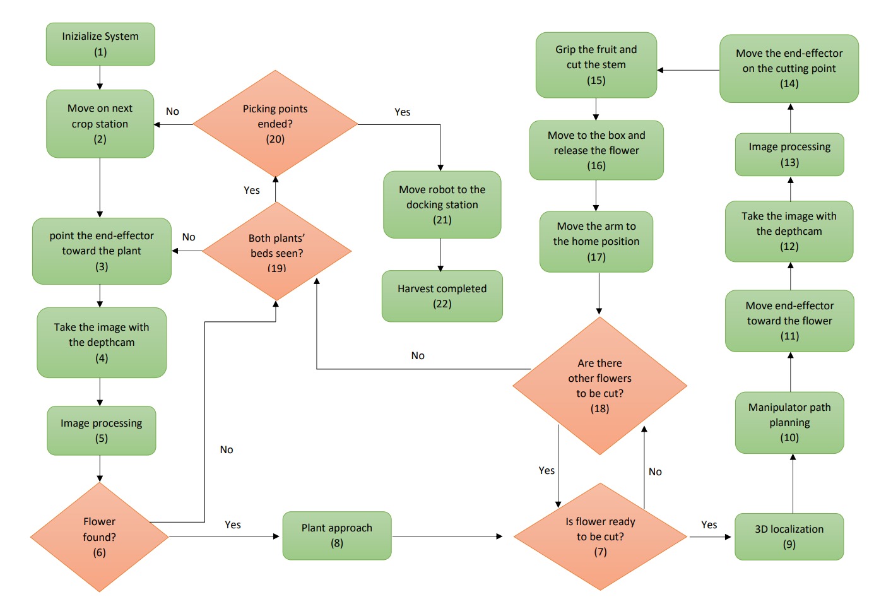
Algorithm

Slide 4
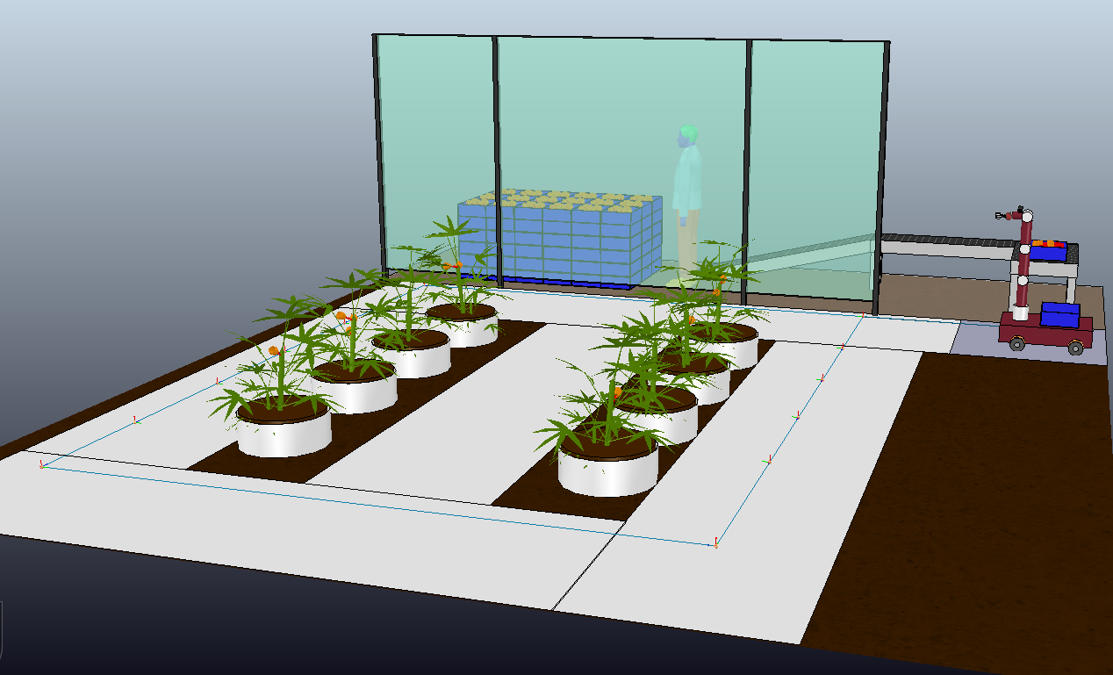
Application environment

Slide 5
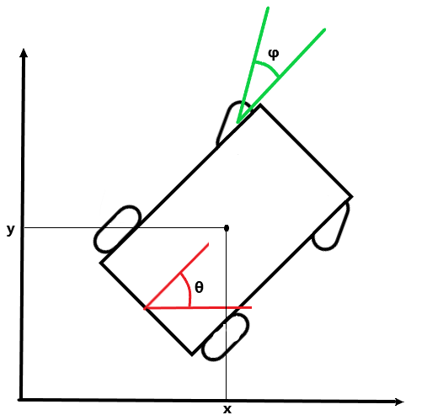
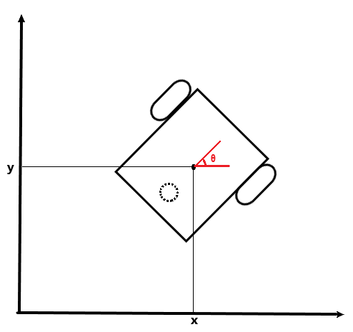
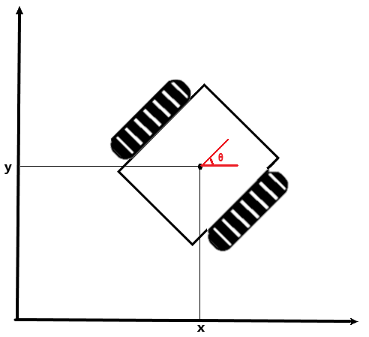
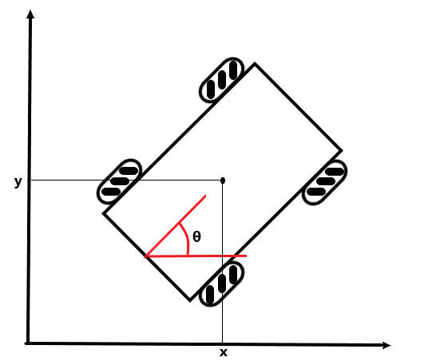
Mobile Platform
Three different mobile platform have been considered:
Car-like robot
Differential-drive robot
Mecanum wheels robot

Slide 6
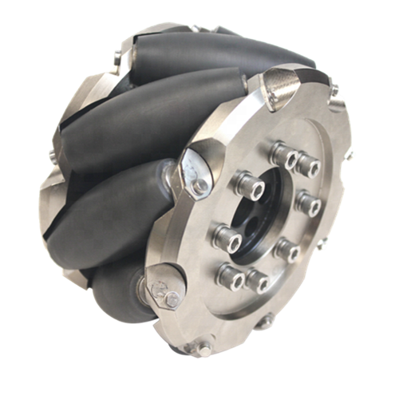
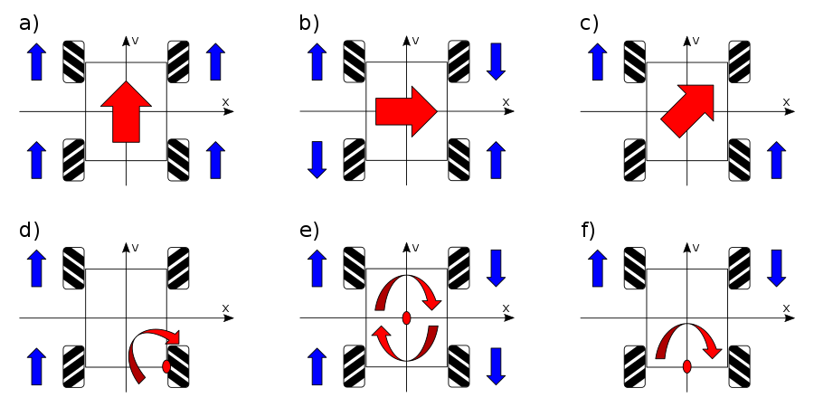
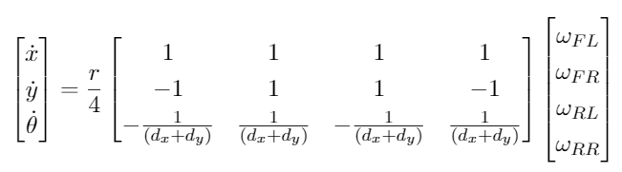
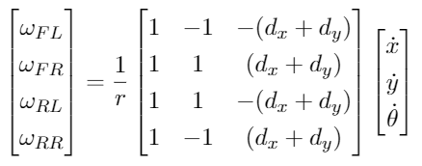
Mecanum wheeled robot
Direct Kinematic model
Inverse Kinematic model

Slide 7
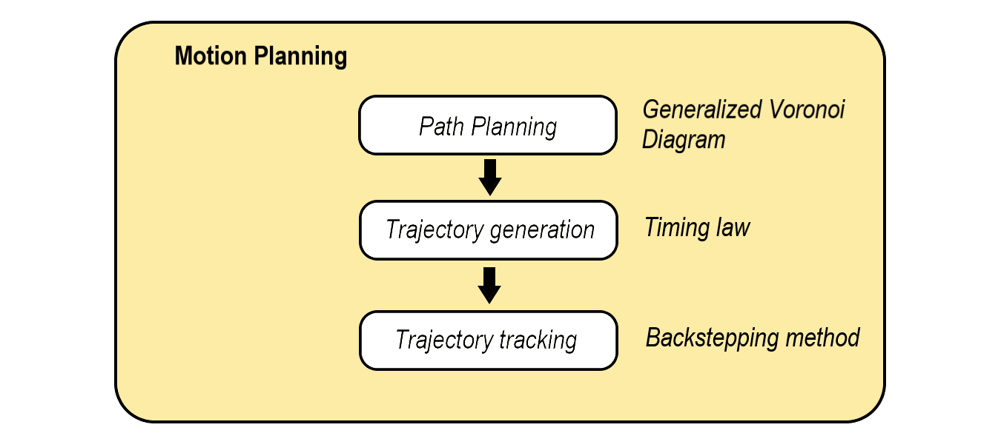
Motion Planning

Slide 8
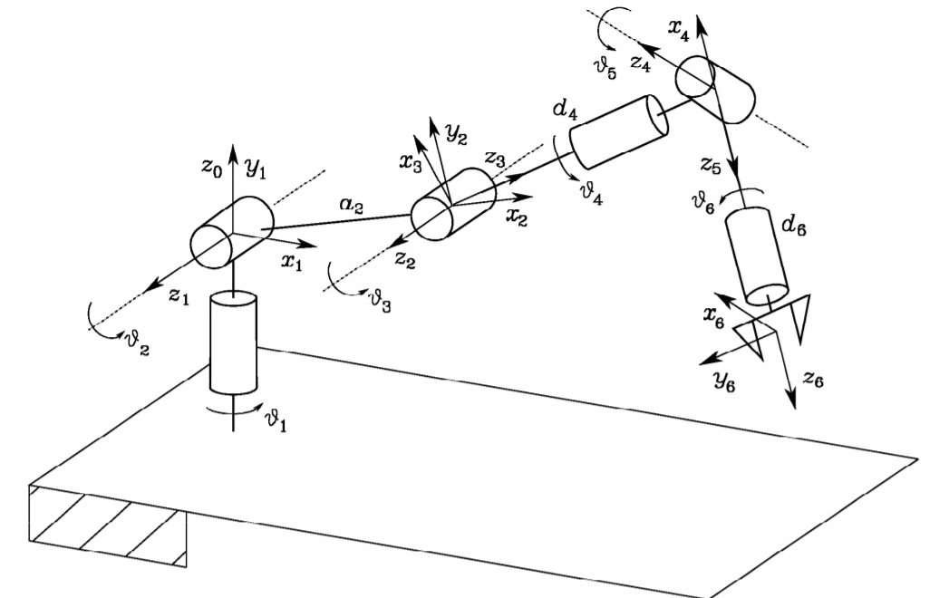
Robotic Arm
The robotic arm choosen for this work is a general 6 dof robotic arm. This arm has been studied under its kinematic and differential kinematic point of view. These kinematic dependences will be then used in the simulation for the control of the robot

Slide 9
Vision System
An important module of the robotic arm is the vision system. For this system an RGB-D camera has been choosen.
These system is mainly used for the recognition, identification and localization of the flowers inside the environment.
Thanks to some algorithm which i’ve developed based on the k-mean clustering and the euclidean ……….. The robot is able to recognise if there are flowers on a plant or not, it is able to separate each flower stem and finally it is able to localizate the flowers in the image space and with the depth informations also in the 3D environement.

Slide 10
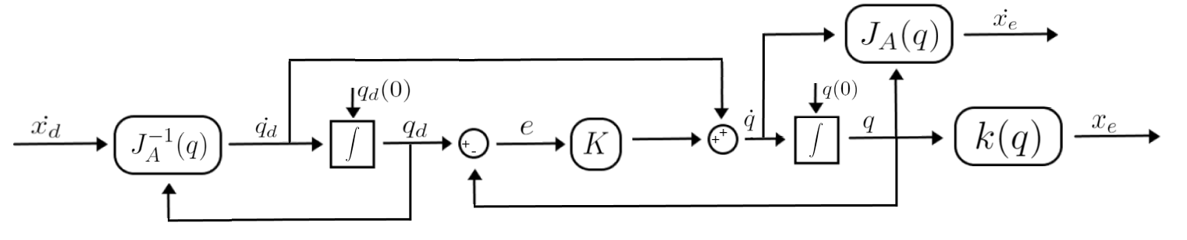
Robotic arm control
With the previously flower location the robot autonomously create linear path from the end-effector position to the flower position.
Finally a kinemtic control like the one in figure has been chosen to perform the movements.

Slide 11
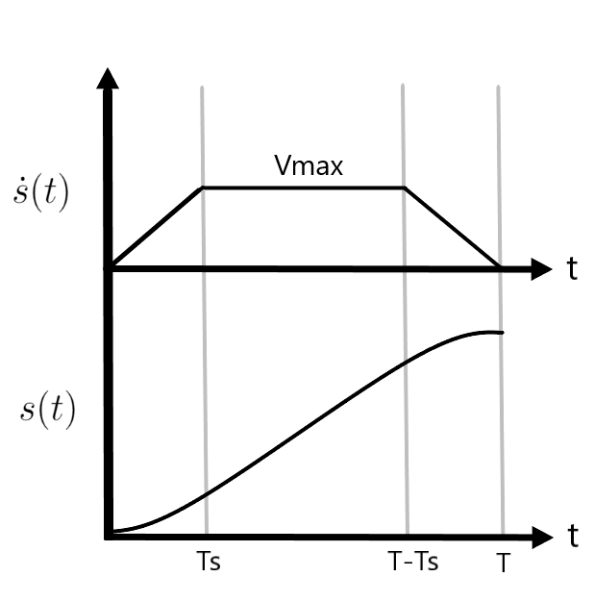

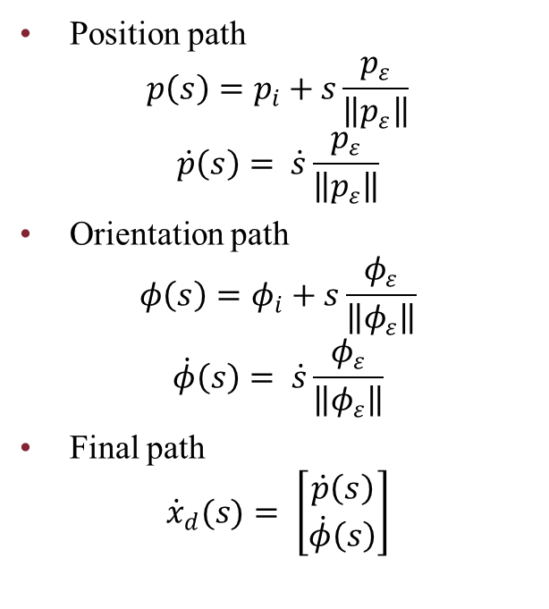

Trajectory generation
Path planning
Timing law
Position path
$$p\left(s\right)=p_{i}+s\frac{p_{ε}}{\left\|p_{ε}\right\|}$$
$$\dot{p}\left(s\right)= \dot{s}\frac{p_{ε}}{\left\|p_{ε}\right\|}$$
Orientation path
$$φ\left(s\right)=φ_{i}+s\frac{φ_{ε}}{\left\|φ_{ε}\right\|}$$
$$\dot{φ}\left(s\right)= \dot{s}\frac{φ_{ε}}{\left\|φ_{ε}\right\|}$$
Final path
$${\dot{x}}_{d}(s)= \left[\begin{matrix}\dot{p}\left(s\right) \\ \dot{φ}\left(s\right)\end{matrix}\right]$$
$$T_{S}=\frac{V_{max}}{A_{max}}$$
$$T= \frac{lA_{max}+V_{max}^{2}}{A_{max}V_{max}}$$
$$\dot{s}\left(t\right)=\left\{\begin{aligned}A_{max}t, t ε \left[0,T_{s}\right] \\ &V_{max}, t ε \left[T_{s,}T−T_{s}\right] \\ \begin{matrix}−A_{max}\left(t−T\right), & t ε \left[T−T_{s},T\right]\end{matrix}\end{aligned}\right.$$

Slide 12
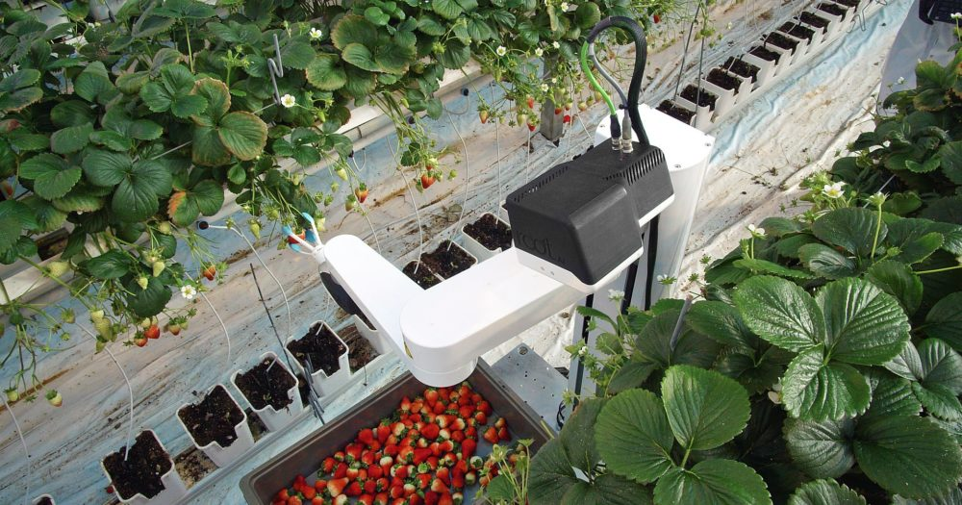
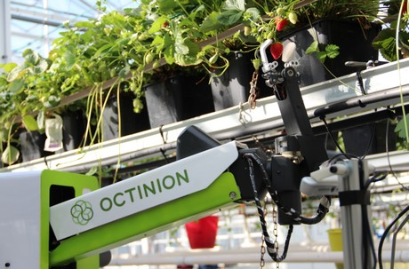
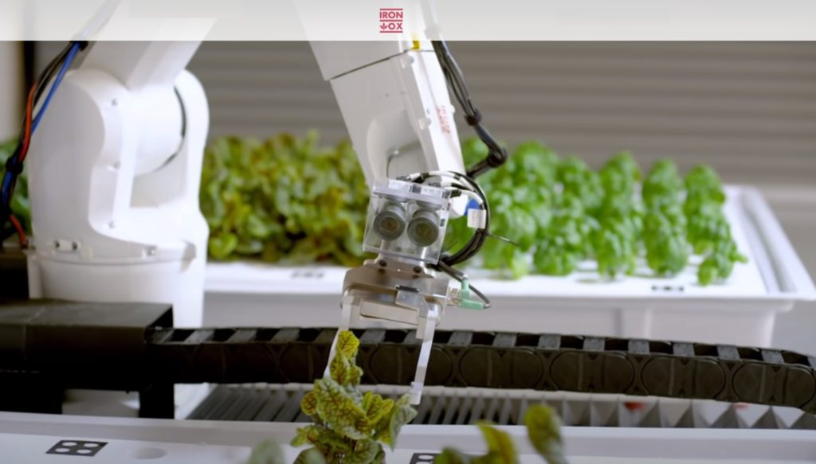
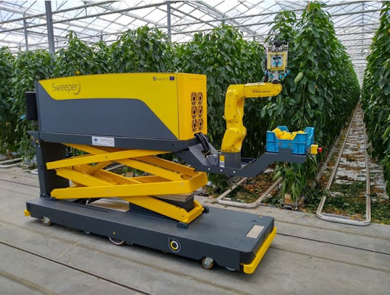
Existing prototypes

Slide 13
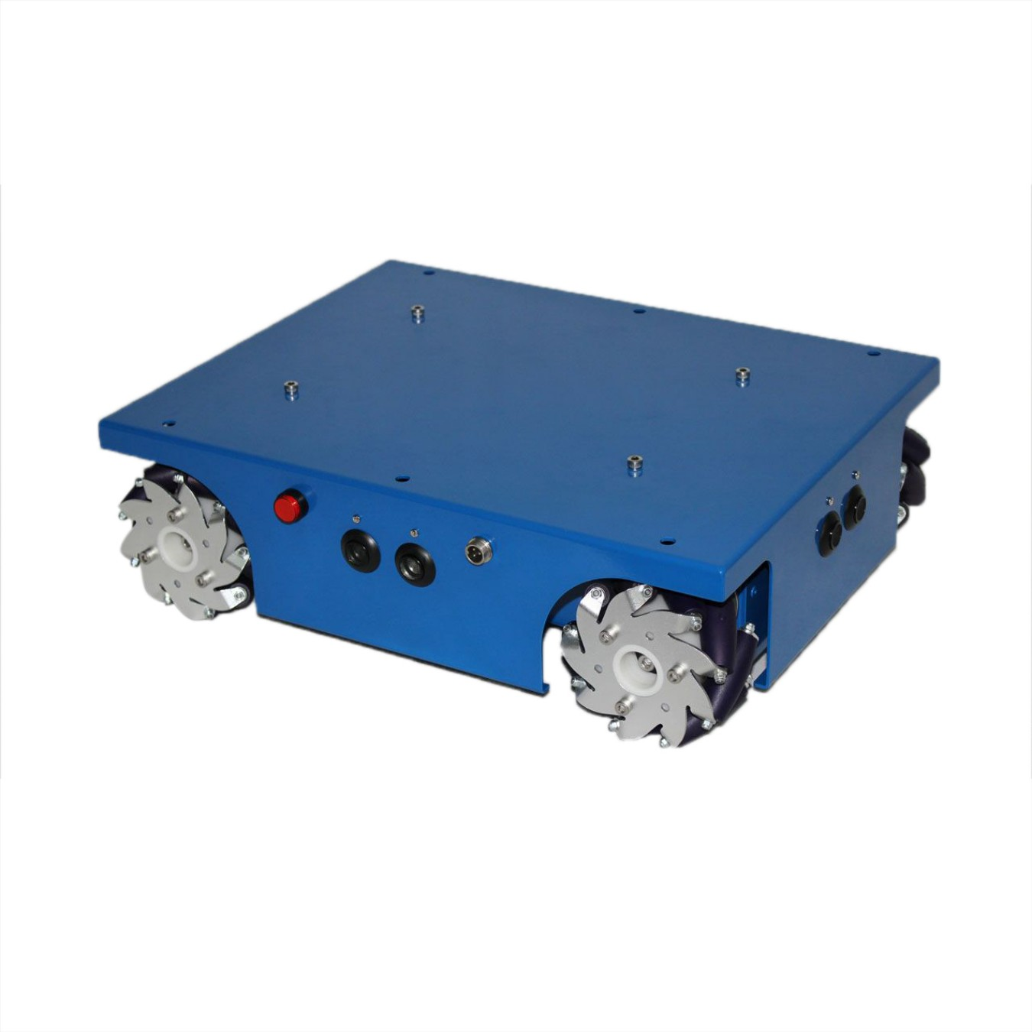
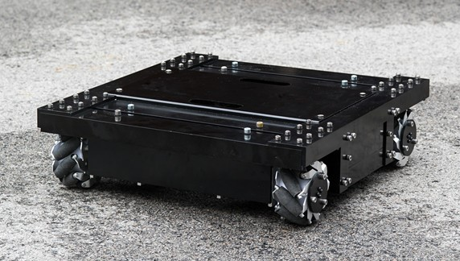
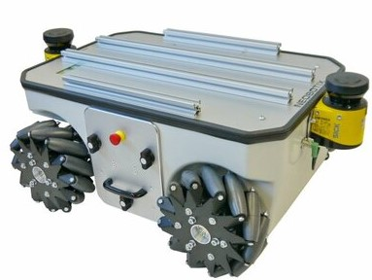
New prototypes – Mobile platform

Slide 14
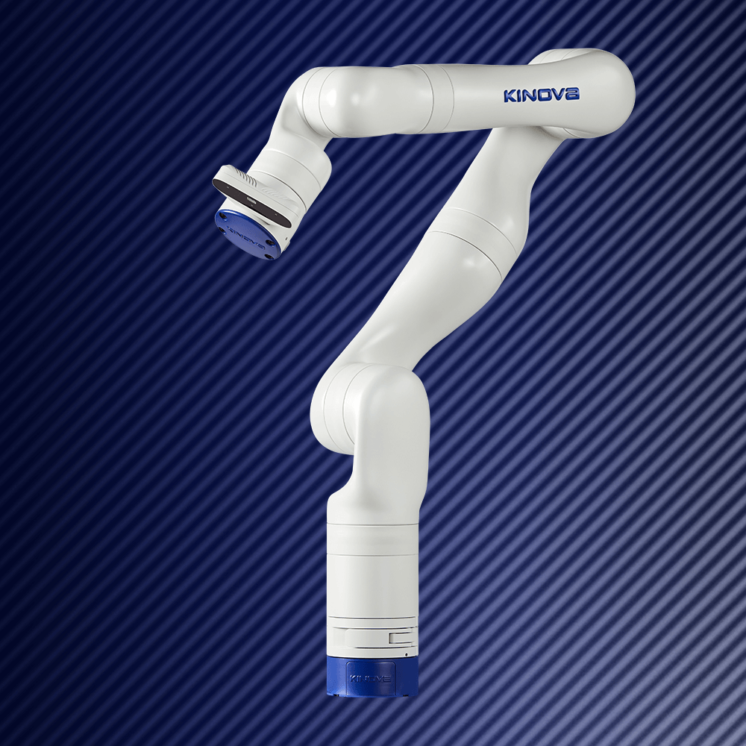
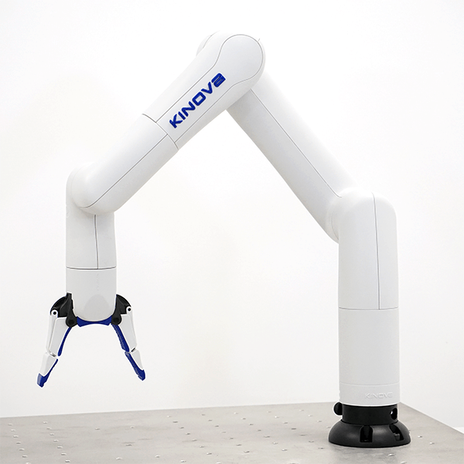
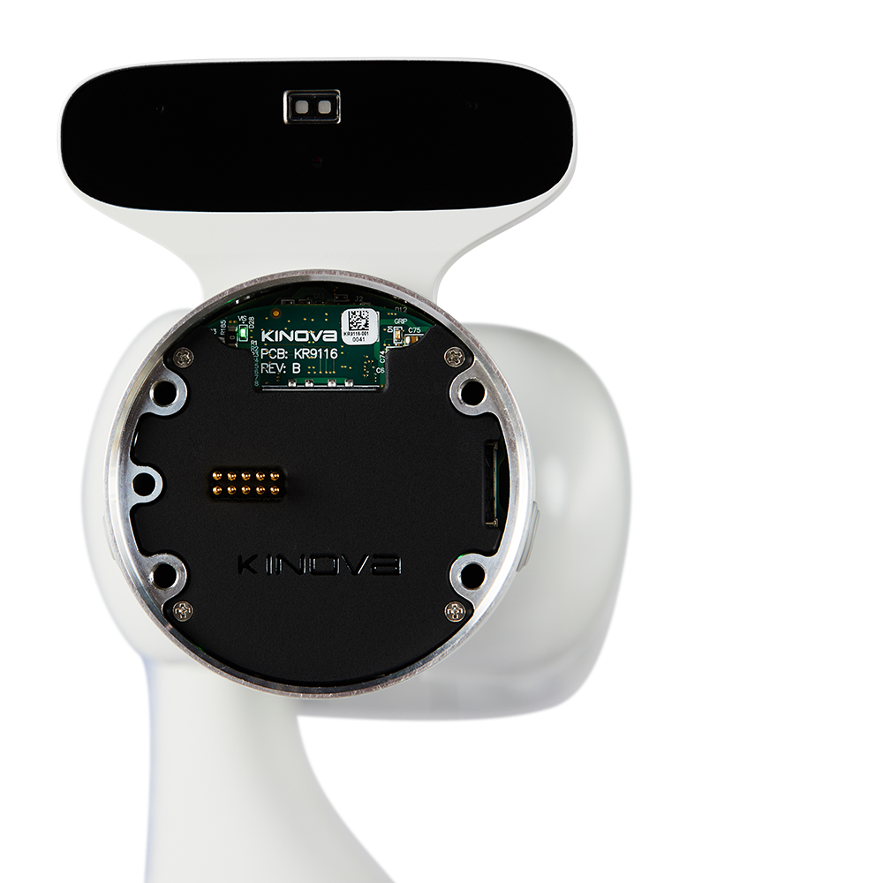
New prototypes – Manipulator arm

Slide 15
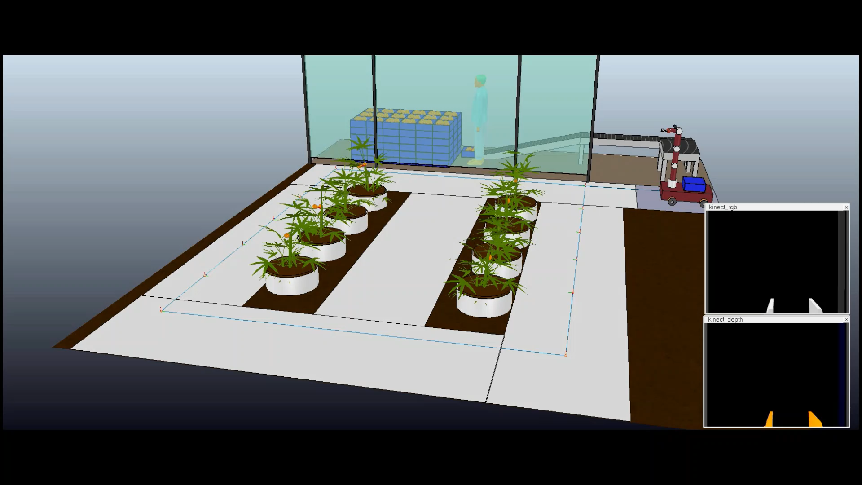
Simulation

Slide 16
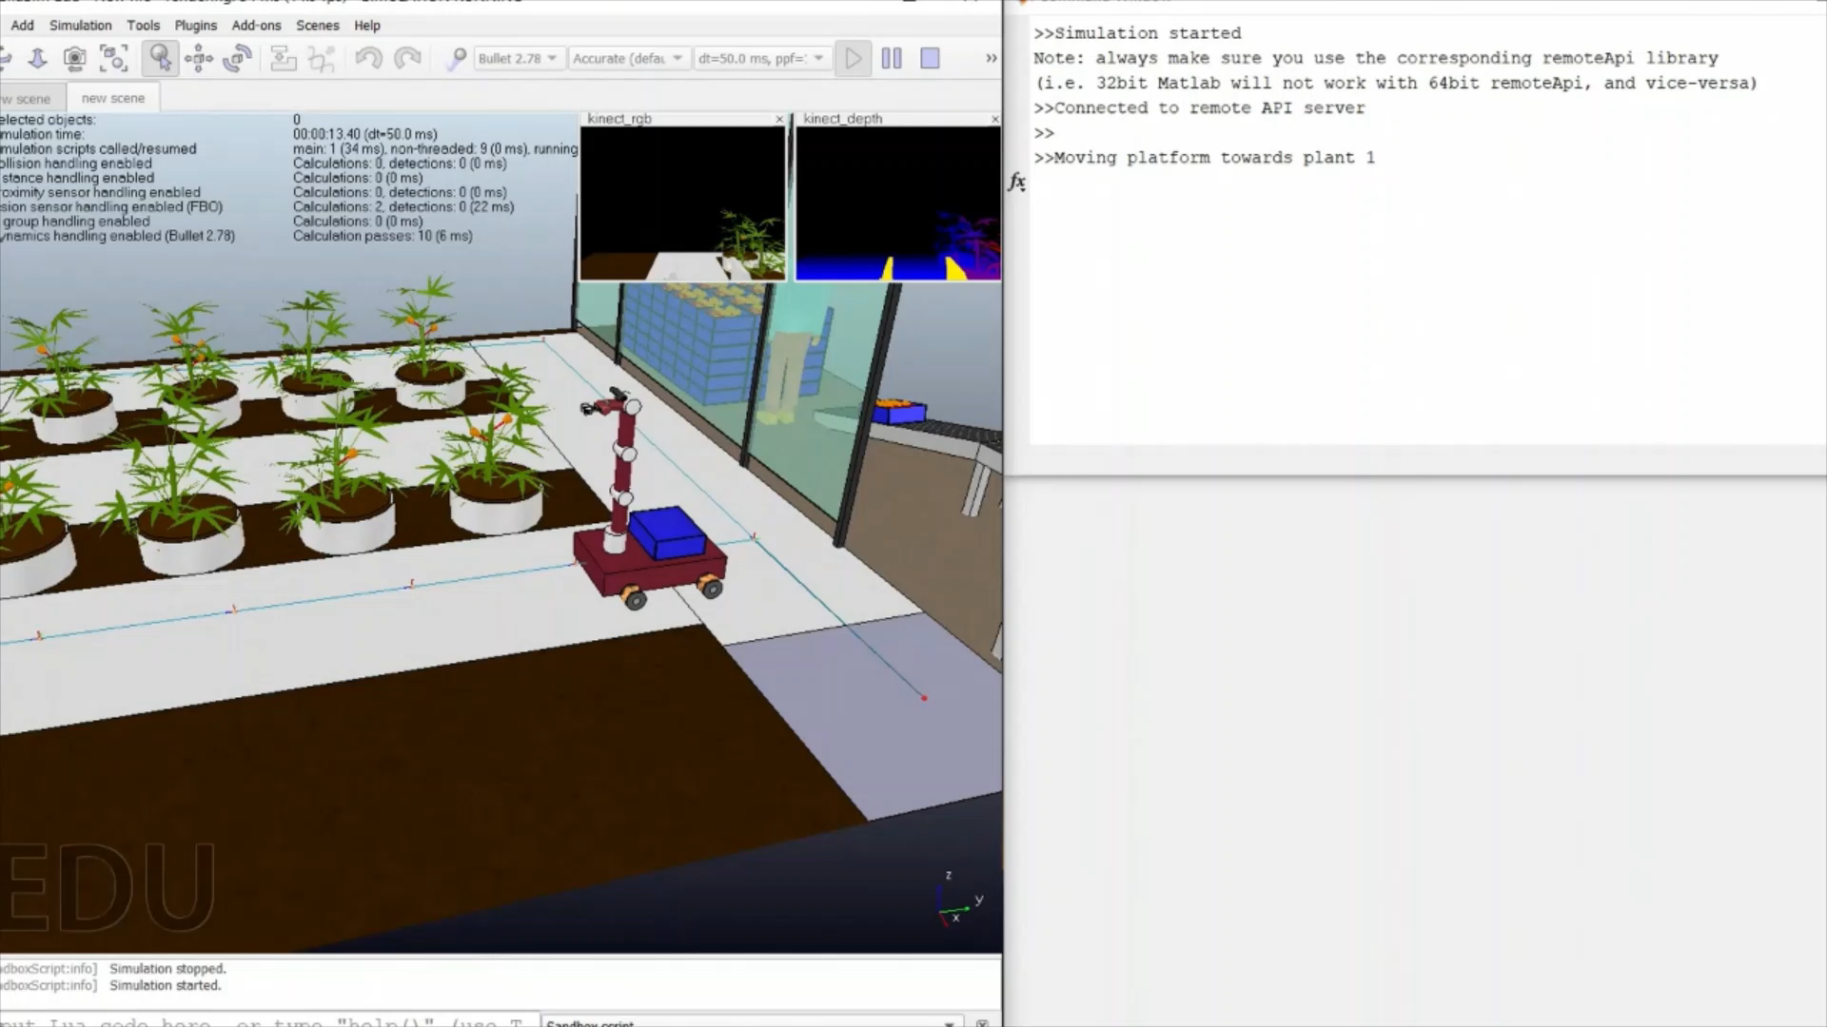
Simulation

Slide 17
Conclusion
Althought the project has been simplified, the simuation had proven that the algorithms and the structure used works. The study, the design and the simulation have ……………….
Future improvements:
Implement a localization systems
Use multiple robots - distributed systems
Improve the machine learning algorithms
Use a more sophisticated robot controller
Others

Slide 18
Acknowledgements
My gratitude goes to my family whose has allowed this moment, my girlfriend who has always supported me and to my university colleagues and the professors whose has made this moment possible.
Thank you

